Slide 1
Achieving Balance
ACE Workshop – September 30, 2014

Slide 2
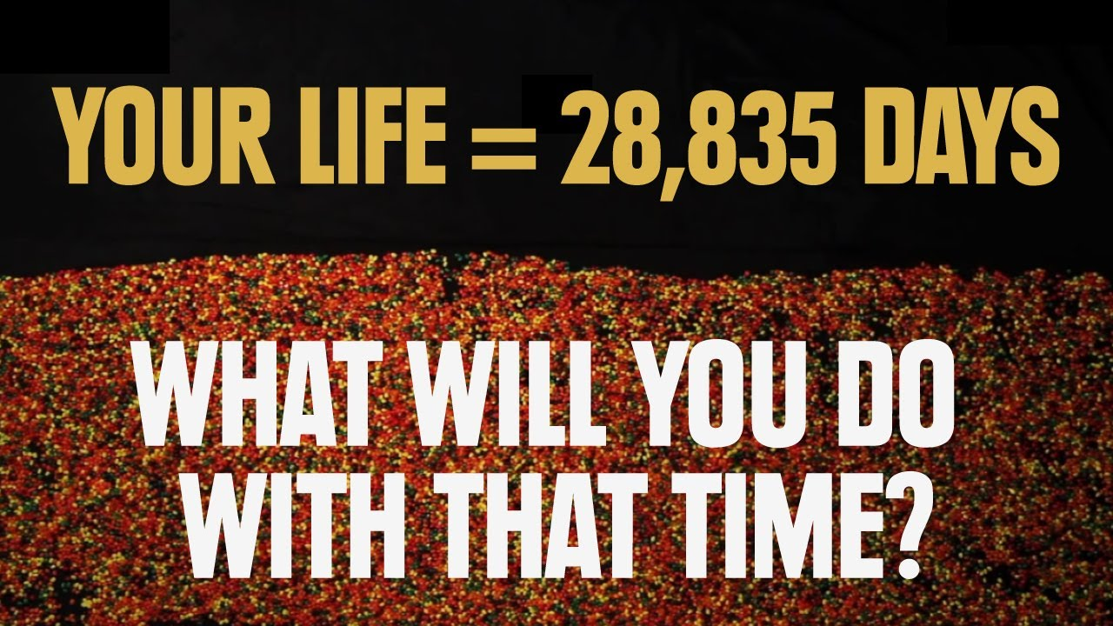
The Time You Have In Jellybeans

Slide 3
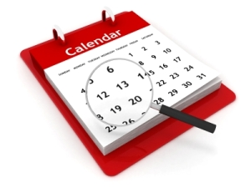
Long-Term Planning vs. Short-Term Planning

Slide 4
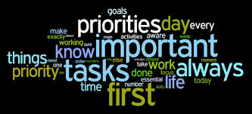
How do you effectively manage your time?
What is the biggest time waster for you?
What does “balance” mean to you?
How do you create balance in your life?
What is one thing that you know you need in your life in order
to be successful?

Slide 5

Balance looks different for everyone. There is no secret formula to perfect time management. For some, making a to-do list is motivating. For others, a to-do list is paralyzing.
Achieving Balance requires time, patience, and effort.
Think of time management as goal-setting – what do I have to get done and how much time do I have?
If you were to add up all the things you want to accomplish in one week – what would it add up to? (Remember, you do have to sleep ☺).

Slide 6
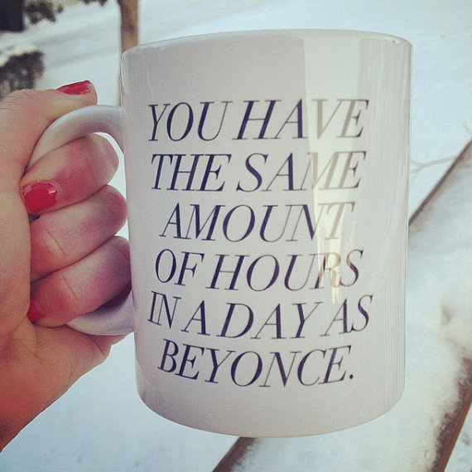

Slide 7
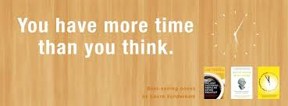
The “168 Hours” Theory
“Busy” vs. “Productivity”
Write down what you are doing, in as much detail as you want. “Schoolwork” and “wrote essay for UCWR 110” are both fine, but one gives you more info to work with later.
Think of yourself as an attorney billing your time to different projects. Keep the spreadsheet with you. If you forget to record what you’re doing for a while, just approximate the time later.
Keep going for 168 hours. You might want to try a second week too, as recording your time is a habit, and building habits takes time.
After you’ve recorded 168 hours, break your activities down into categories. How much time did you spend working? Commuting? Interacting with your family? Sleeping? Exercising? Doing personal care (like showering or doing your hair)? Doing housework or household administration? Watching television? Reading?
Do these numbers reflect the number of hours you’d like to “bill” to these projects? What do you think would be ideal?
Can you change your schedule to get closer to that ideal?

Slide 8
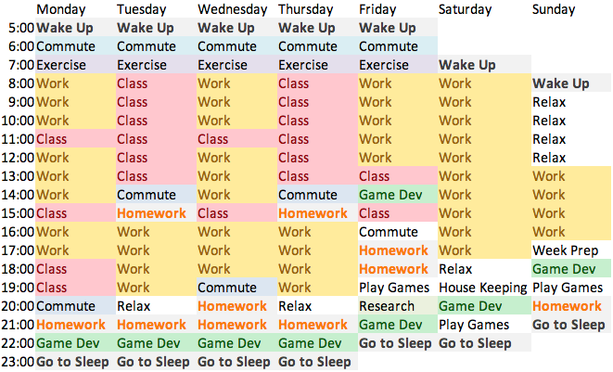
What is Your Ideal Schedule?

Slide 9

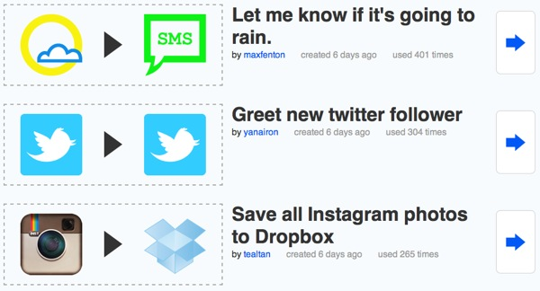


There’s an app for that!
Sleep Cycle
Analyzes your sleep cycle; wake you up at the end of your REM Cycle – The goal is that you wake up feeling refreshed and relaxed
Evernote is the app that saves everything you need—literally. You can type a note, take a photo, record audio or attach a file in this app that syncs to all your connected devices. The more you use it, the more uses you’ll find for it. (For starters, it’s great for group projects and term paper research.) For iOS and Android.
Website Blockers
Self-control
GetColdTurkey.com
Stay Focusd
IFTTT—If This Then That—(above) is a new kind of app that lets you build recipes, but not for food. The “recipe” is a sequence of commands that executes when a particular catalyst is selected: for example, “If I’m tagged in a photo on Facebook, then send me a text message” or “If it’s raining tomorrow, then send me a reminder to leave early for class.” Since IFTTT can sync with many, many apps, the recipe possibilities are numerous. For iOS and Android.

Slide 10
Reflection
Reflect on Today’s Workshop…
What are your long-term and short-term goals
How do you effectively manage your time?
How do you want to manage your time batter?
What is the biggest time waster for you?
What does “balance” mean to you?
How do you create balance in your life?
What is one thing that you know you need in your life in order to be successful?
http://www.donothingfor2minutes.com/

